Slide 1

Superhero U Facebook Campaign Ad Report
By Group 14A

Slide 2
Group 14A
Team Lead - Kwarteng ….

Slide 3
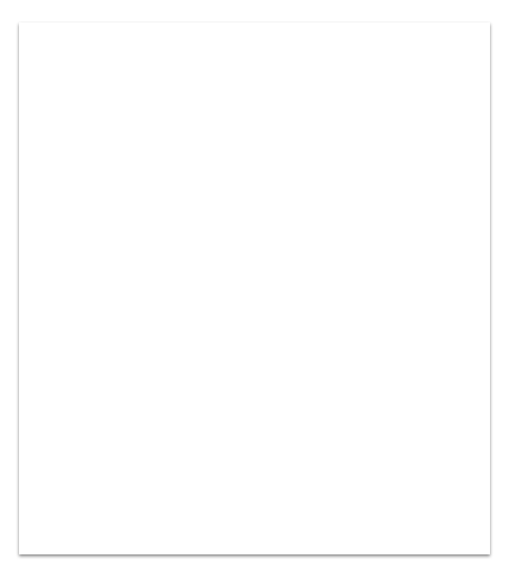

SUPERHERO U EVENT
Superhero U event is a competition targeted at Interns. A Facebook Ad was used for advertising the campaign, which is known as “Link click” ad, such that when a person clicks on the image it leads to the Superhero U website.

Slide 4

FACEBOOK AD:
Facebook ads which is short for Facebook Advertising are paid promotional content that businesses or individuals can create to advertise their products, services, or brand on Facebook. There are various ad formats to choose from, and advertisers can target their ads to specific demographics, interests, behaviors, and location. Facebook ads can be seen on Facebook, properties, other websites, and mobile apps. Advertisers can use Facebook's Ads Manager tool to monitor ad performance and optimize their campaigns for better results.

Slide 5
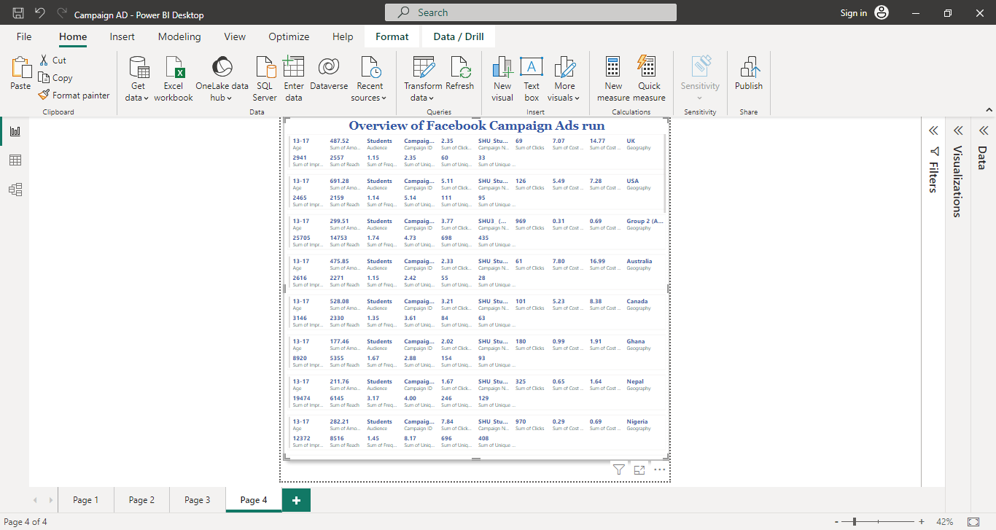
OVERVIEW OF ALL CAMPAIGN ADS
Here is an overview of all Superhero U campaign ads that was carried out by the marketing team:

Slide 6
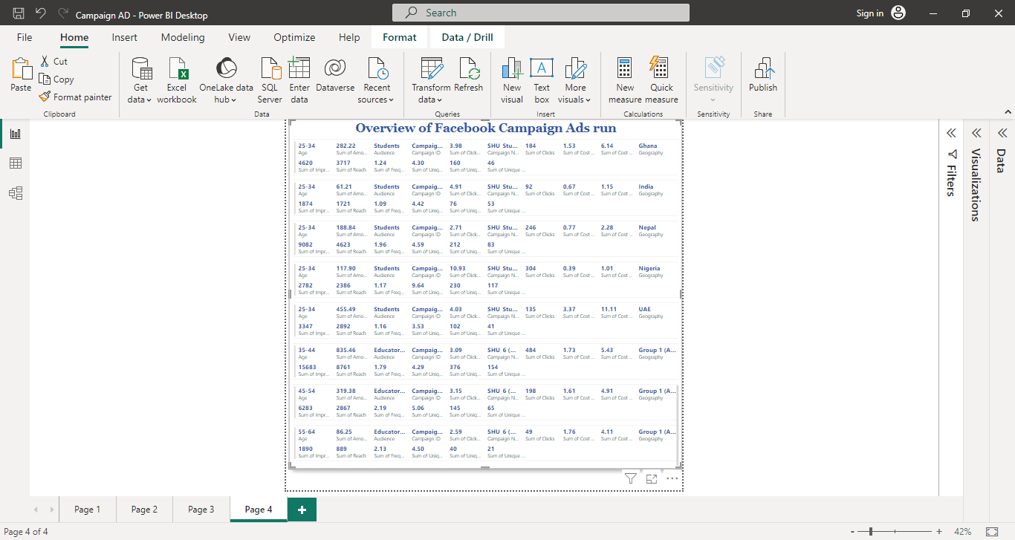

Slide 7
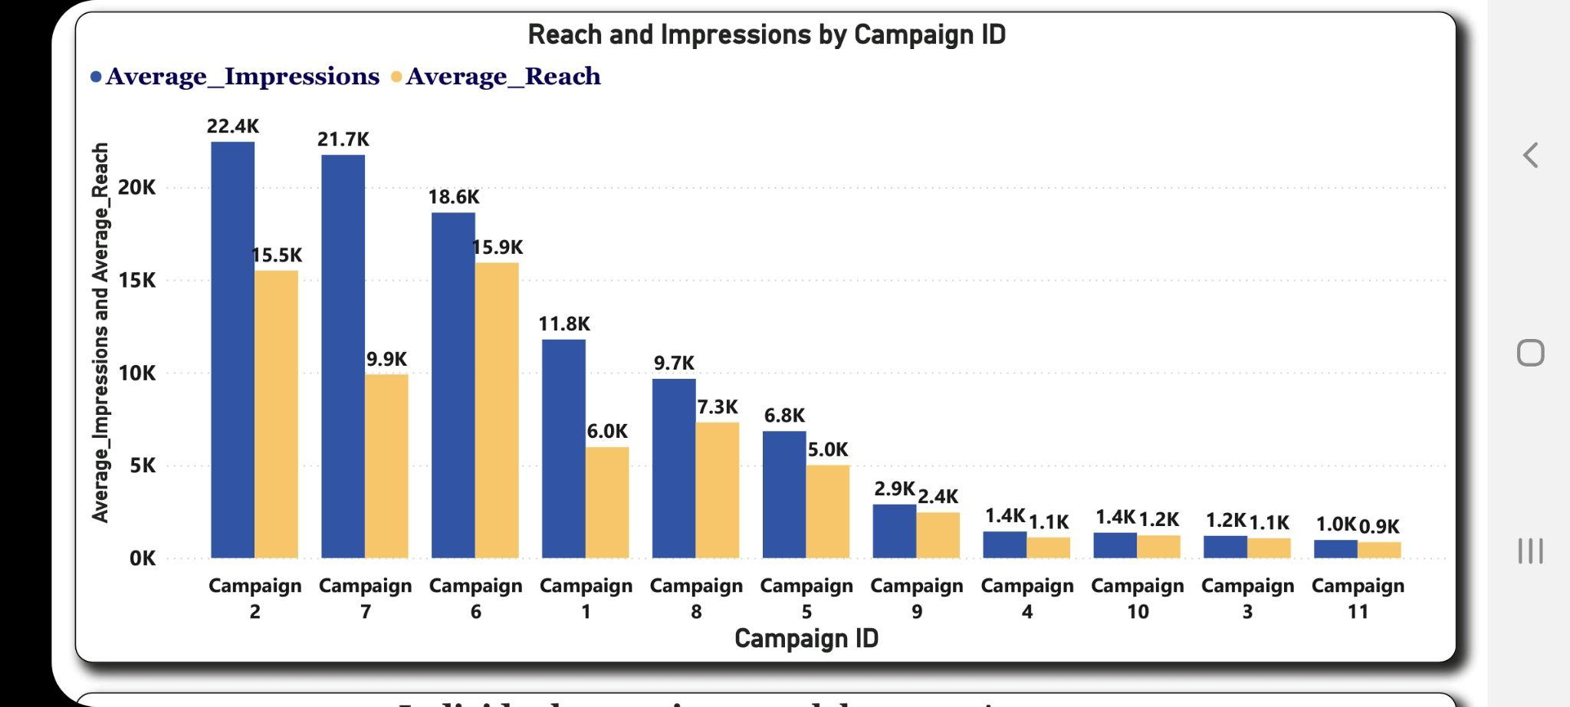
The graph shows the relationship between campaign reach and impression by each campaign ID, revealing that campaign 3 and 11 has the least amount of clicks and impression as shown within the red box.
VISUALIZATION 1:

Slide 8
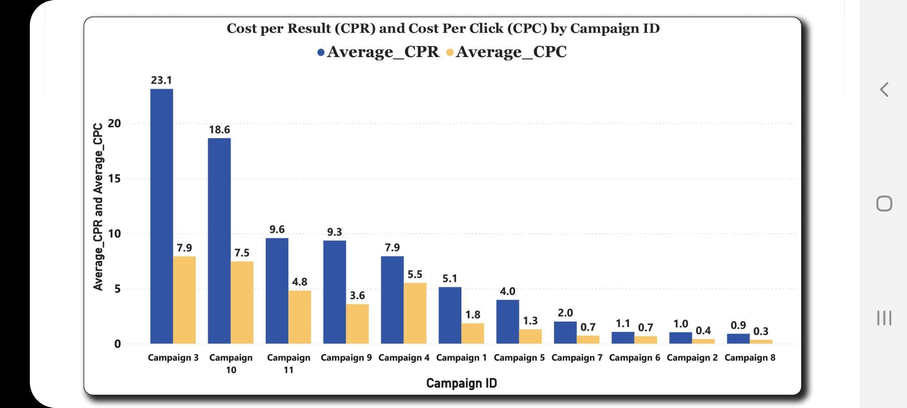
VISUALIZATION 2:
This graph shows the relationship between the cost per result and the cost per click by each campaign ads. Revealing that Campaign 3,10 and 11 cost us so much as shown in the red box.

Slide 9
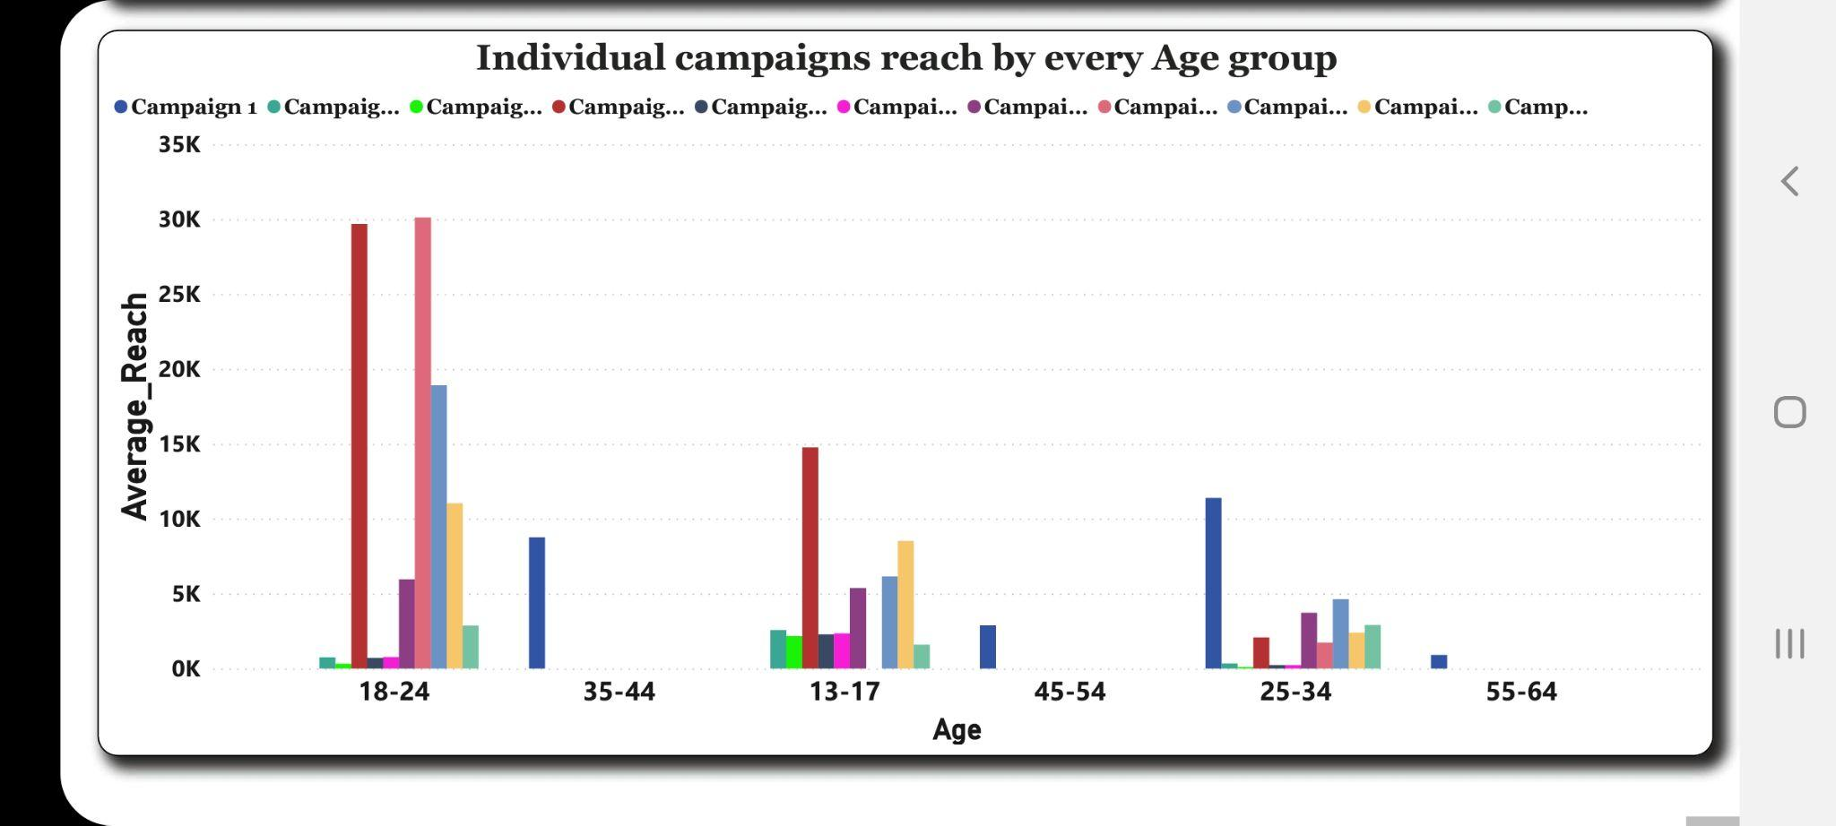
VISUALIZATION 3:
The graph reveals the relationship between different age groups that were reached by each individual campaign ad.
It is seen that campaign 3(deep purple in colour) and campaign 11(green) had the lowest reach across just 1 age group as shown with the red arrows.

Slide 10
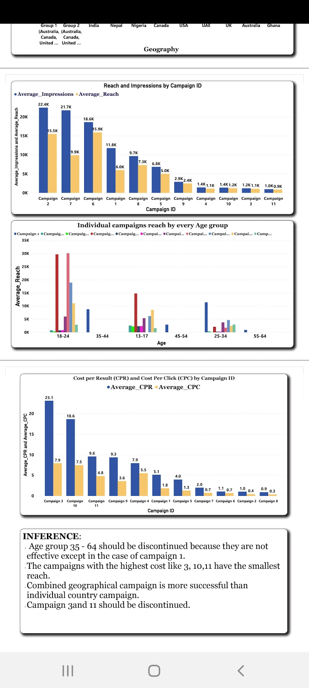
CONCLUSION:
Based on Visualization 1, 2 and 3; it is advised to discontinue campaigns 3 and campaign 11 as they have the least reach(Visualization 1,3) and the highest cost per click and per result(Visualization 2).

